Slide 1
Presentation and Graphical Representation of Data
Made By:
Ms. Kiran Malik
(Assistant Professor)

Slide 20
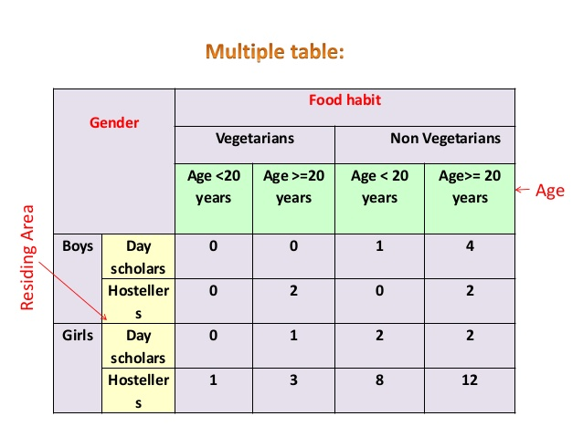

Slide 21
Graphical Representation of data

Slide 25
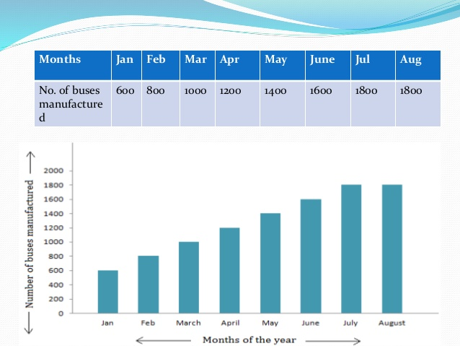

Slide 43
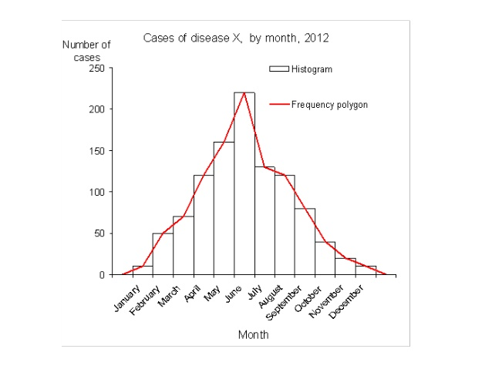

Slide 47
